Slide 1
Project management
Organising, planning and scheduling software projects
Objectives
  To introduce software project management and to describe its distinctive characteristics
  To discuss project planning and the planning process
  To show how graphical schedule representations are used by project management
  To discuss the notion of risks and the risk management process

Slide 2
Topics covered
Management activities
Project planning
Project scheduling
Risk management

Slide 3
Software project management
Concerned with activities involved in ensuring
that software is delivered
  on time
  within the budget
  in accordance with the requirements
Project management is needed because software development is always subject to budget and schedule constraints
  Set by the development organisation or the customer

Slide 4
Software management distinctions
The product is intangible
The product is uniquely flexible
The product is uniquely complex
Software engineering is not recognized as an
engineering discipline with the same status as
mechanical, electrical engineering, etc.
The software development process is not
standardised
Many software projects are “one-off” projects

Slide 5
Management activities
Proposal writing
Project planning and scheduling
Project costing
Project monitoring and reviews
Personnel selection and evaluation
Report writing and presentations

Slide 6
Project staffing
May not be possible to appoint the ideal people to work on a project
  Project budget may not allow for the use of highly-paid staff
  Staff with the appropriate experience may not be available
  An organisation may wish to develop employee skills on a software project
    Here’s Bob. He’s a sophomore. He’ll be a member of your HazMat Rover team. He doesn’t know much yet, but he can brew a mean cup of coffee and has a great personality. ☺
Managers have to work within these constraints
  especially when (as is currently the case) there is an international shortage of skilled IT staff

Slide 7
Project planning
Probably the most time-consuming project management activity
Continuous activity from initial concept through
to system delivery
Plans must be regularly revised as new information becomes available
  Beware of grumbling developers
Various different types of plan may be developed to support the main software project plan that is concerned with schedule and budget

Slide 8
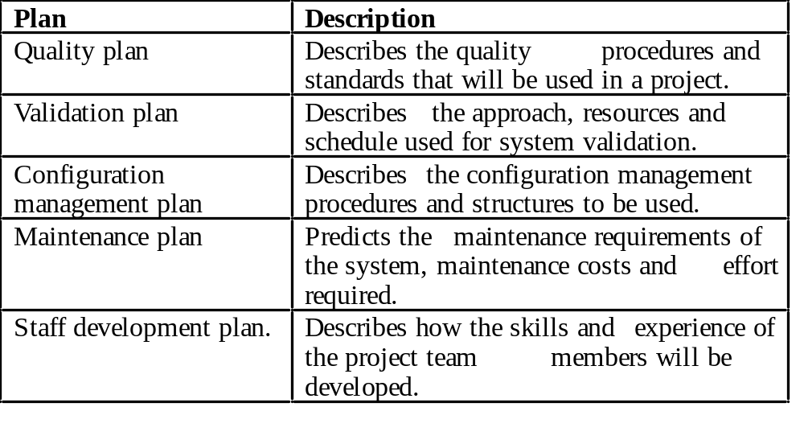
Types of project plan

Slide 9
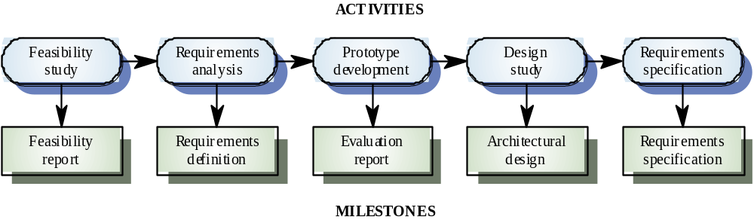
Activity organization
Activities in a project should be organised to produce tangible outputs for management to judge progress
Milestones are the end-point of a process activity
Deliverables are project results delivered to customers

Slide 10
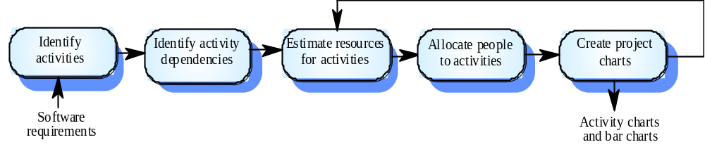
Project scheduling
Split project into tasks and estimate time and resources required to complete each task
Organize tasks concurrently to make optimal use of workforce
Minimize task dependencies to avoid delays
caused by one task waiting for another to complete
Dependent on project managers’ intuition and experience

Slide 11
Scheduling problems
Estimating the difficulty of problems and hence the cost of developing a solution is hard
Productivity is not proportional to the number of people working on a task
  Adding people to a late project makes it later because of communication overheads
The unexpected always happens
  Always allow contingency in planning

Slide 12
Bar charts and activity networks
Graphical notations used to illustrate the project schedule
Show project breakdown into tasks
  Tasks should not be too small
  They should take about a week or two
Activity charts show task dependencies and the the critical path
Bar charts show schedule against calendar time

Slide 13

Task durations and dependencies

Slide 14
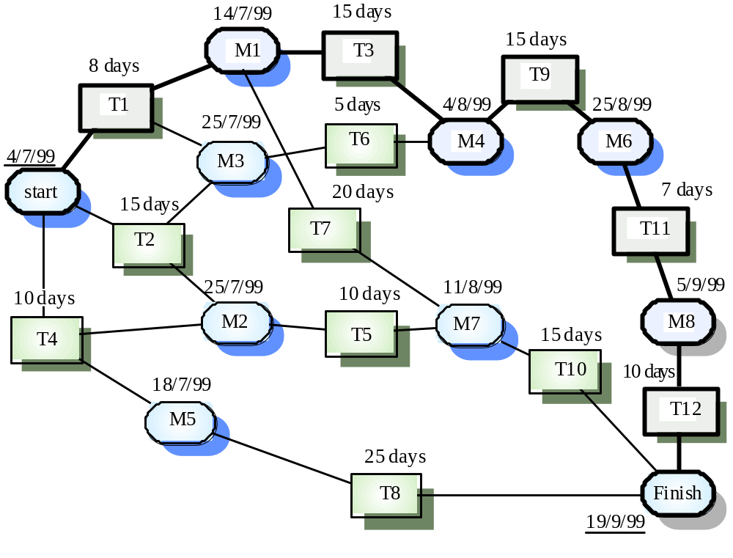
Activity network

Slide 15
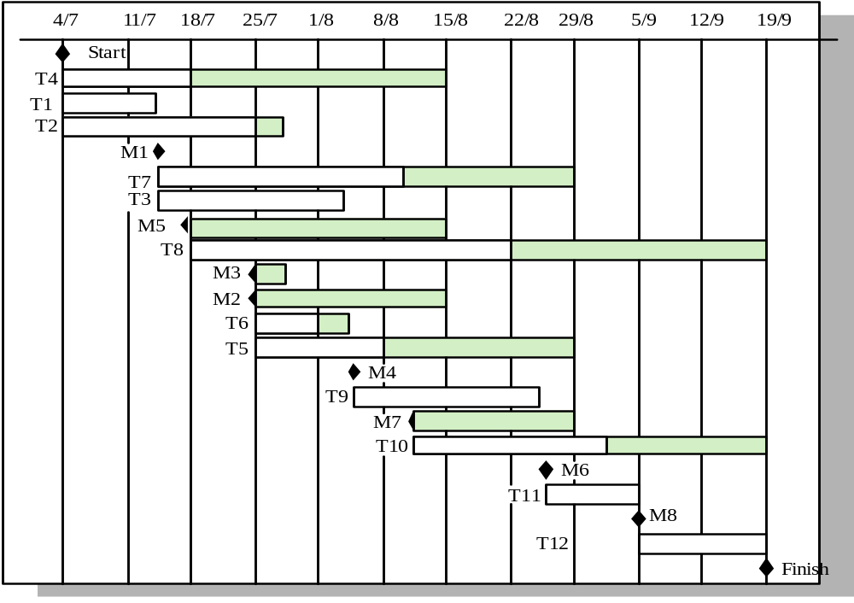
Activity timeline – Gantt chart

Slide 16
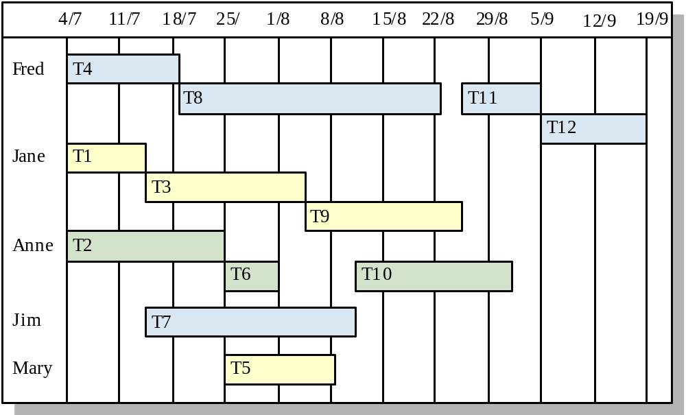
Staff allocation

Slide 17
Risk management
Risk management is concerned with identifying risks and drawing up plans to minimise their effect on a project.
A risk is a probability that some adverse circumstance will occur.
  Project risks affect schedule or resources
  Product risks affect the quality or performance of the software being developed
  Business risks affect the organisation developing or procuring the software

Slide 18
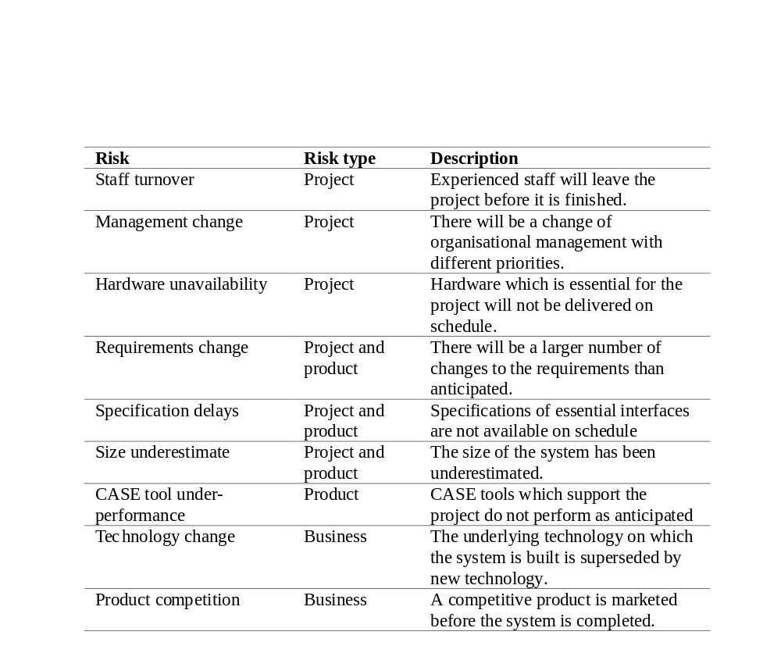
Software risks

Slide 19
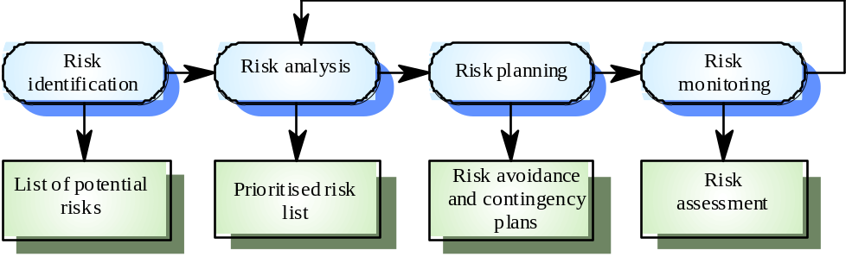
The risk management process
Risk identification – Identify project, product and business risks
Risk analysis – Assess the likelihood and consequences of risks
Risk planning – Draw up plans to avoid/minimise risk effects
Risk monitoring – Monitor the risks throughout the project

Slide 20
Risk identification
Technology risks
People risks
Organisational risks
Requirements risks
Estimation risks

Slide 21
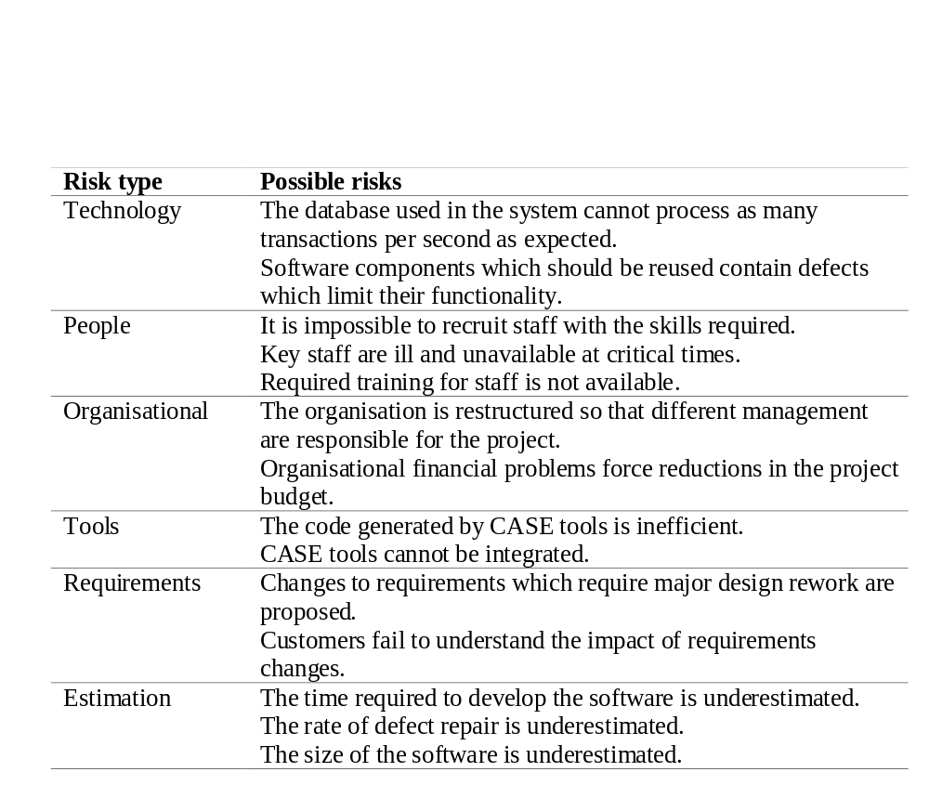
Risks and risk types

Slide 22
Risk analysis
Assess probability and seriousness of each risk
Probability may be
  very low
  low
  moderate
  high
  very high
Risk effects might be
  catastrophic
  serious
  tolerable
  insignificant

Slide 23
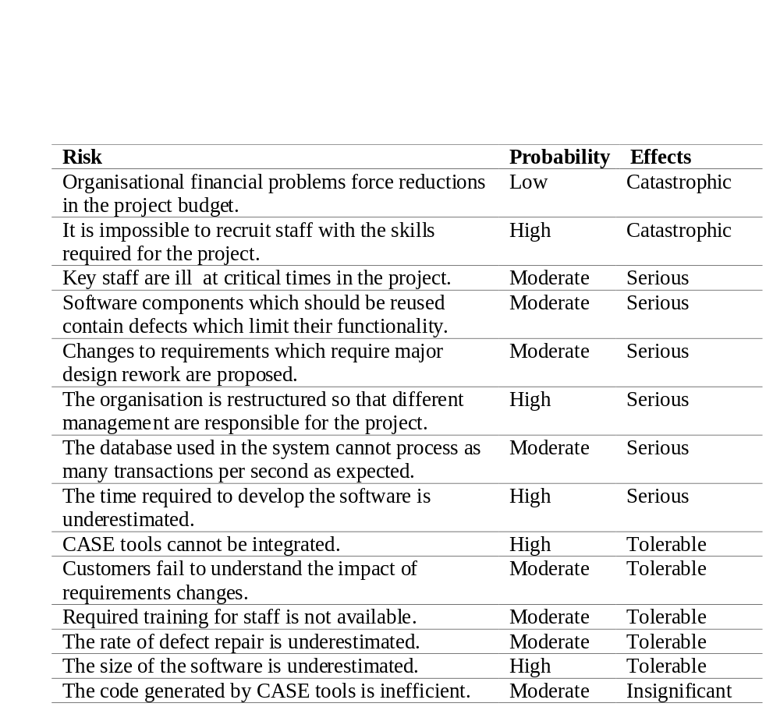
Risk analysis

Slide 24
Risk planning
Consider each risk and develop a strategy to manage that risk
Avoidance strategies
  The probability that the risk will arise is reduced
Minimisation strategies
  The impact of the risk on the project or product will be reduced
Contingency plans
  If the risk arises, contingency plans are plans to deal with that risk

Slide 25
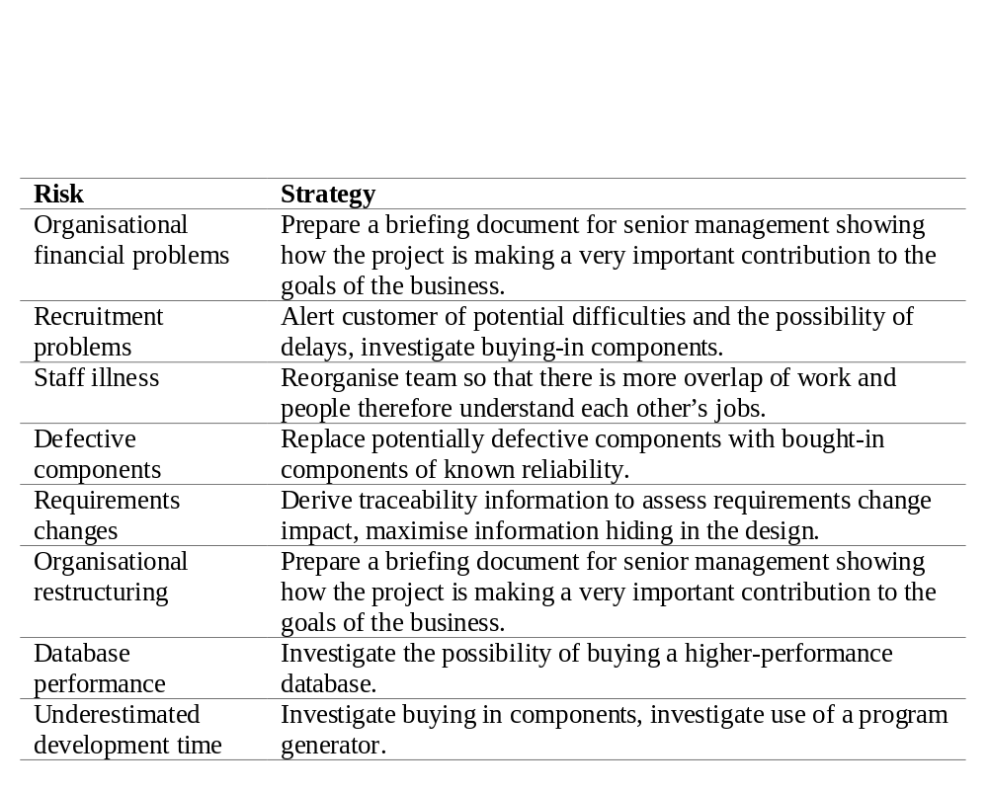
Risk planning strategies

Slide 26
Risk monitoring
Assess each identified risks regularly to decide whether or not it is becoming less or more probable
Also assess whether the effects of the risk have changed
Each key risk should be discussed at management progress meetings

Slide 27
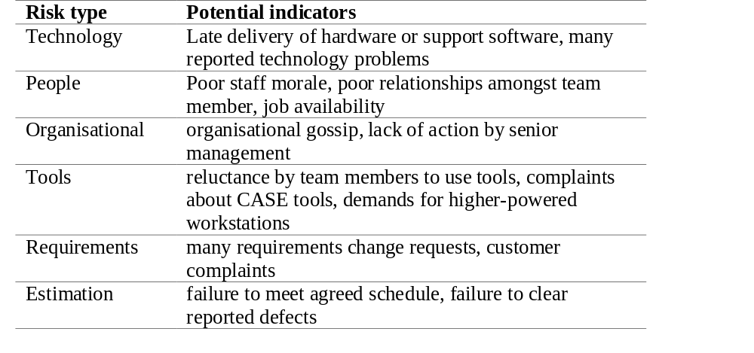
Risk factors

Slide 28
Key points
Good project management is essential for project success
The intangible nature of software causes problems for management
Managers have diverse roles but their most significant activities are planning, estimating and scheduling
Planning and estimating are iterative processes that continue throughout the course of a project
A project milestone is a predictable state where
some formal report of progress is presented to management.
Risks may be project risks, product risks or business risks
Risk management is concerned with identifying risks that may affect the project and planning to ensure that these risks do not develop into major threats

